Slide 1
Enabling IPsec via P4Runtime and OpenConfig
Presenter:
Sabeel Ansari
Jun 1, 2023

Slide 2
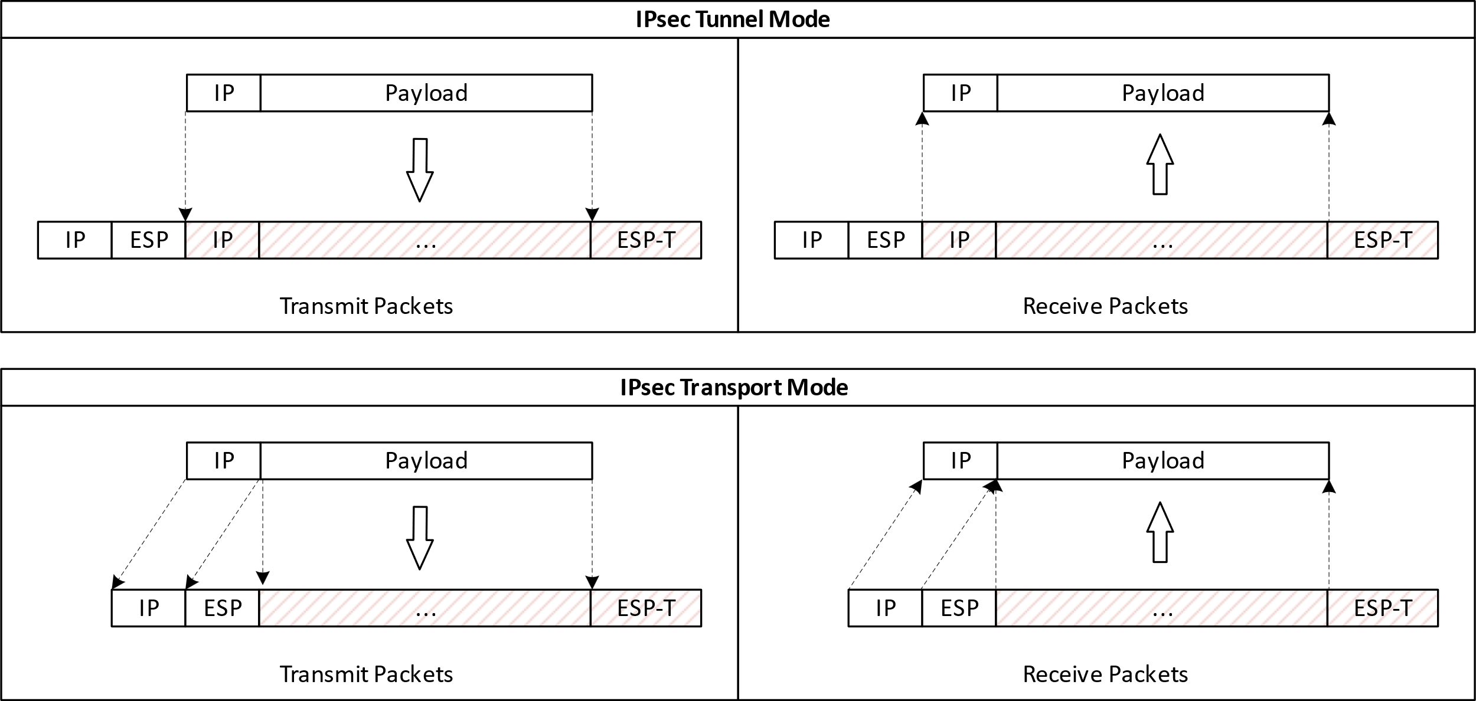
IPsec
IPsec secures the data traffic at IP layer. It is common practice to use a secure tunnel for data transfer
Two protocols:
AH – Authentication Header (does not encrypt payload, obsolete)
ESP – Encapsulating Security Payload
Two modes:
Tunnel Mode
Transport Mode

Slide 3
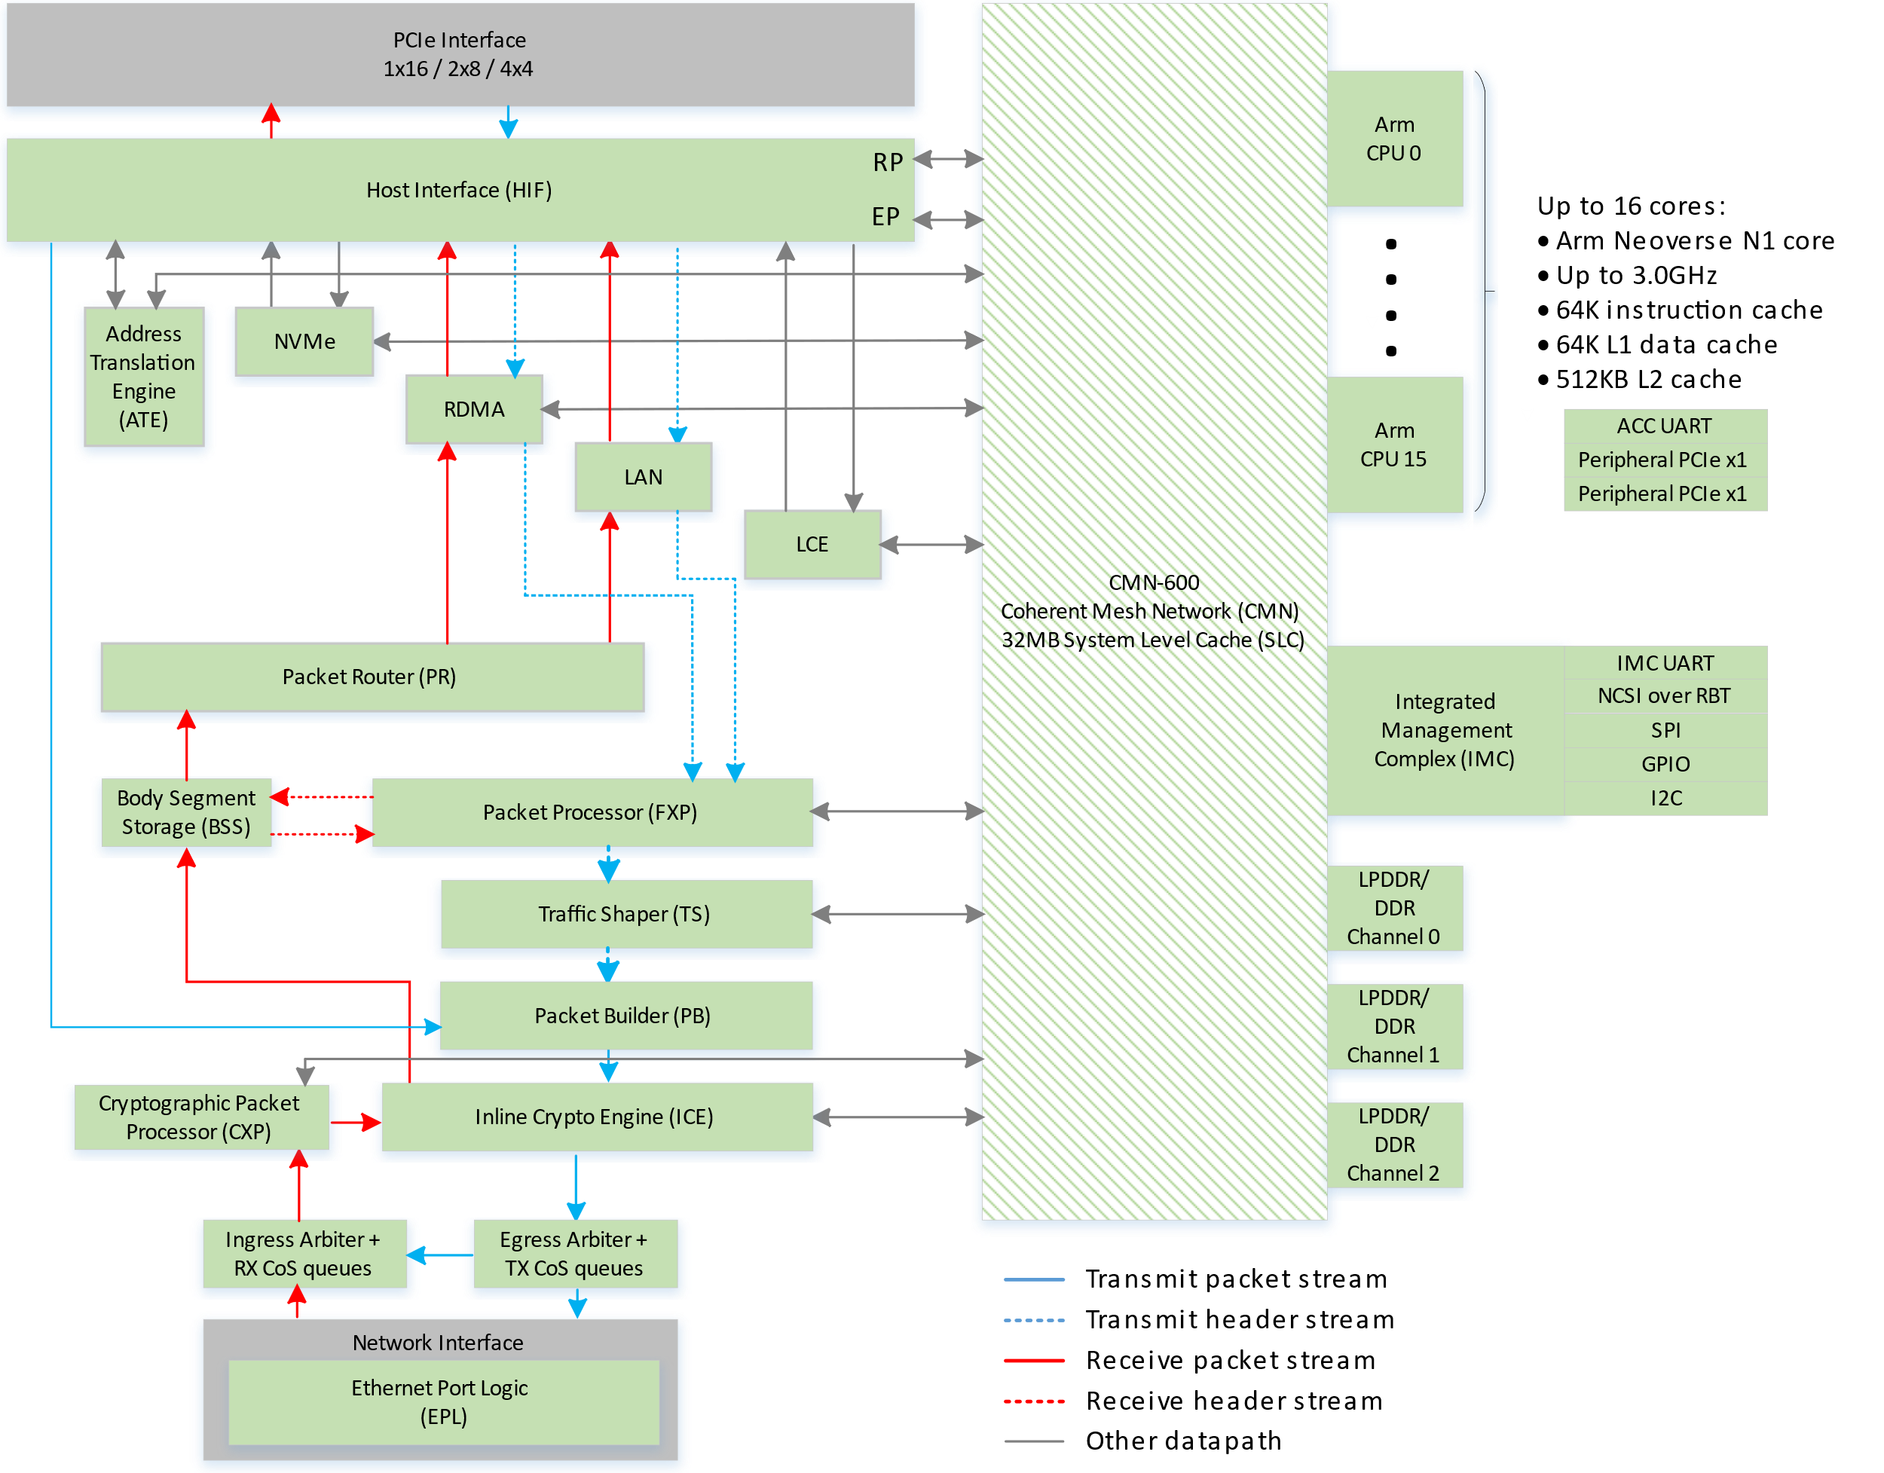
Overview
ICE(Inline crypto Engine) is responsible for processing packets (both ingress and egress directions) that require infrastructure crypto offload in MEV.
ICE is part of NSS pipeline along with FXP and CXP.
ICE supports IPsec full offload in MEV.
All the packets passes through NSS pipeline will pass through ICE.
For Control plane operations to store SADB, ICE has dedicated secure DRAM space.

Slide 4
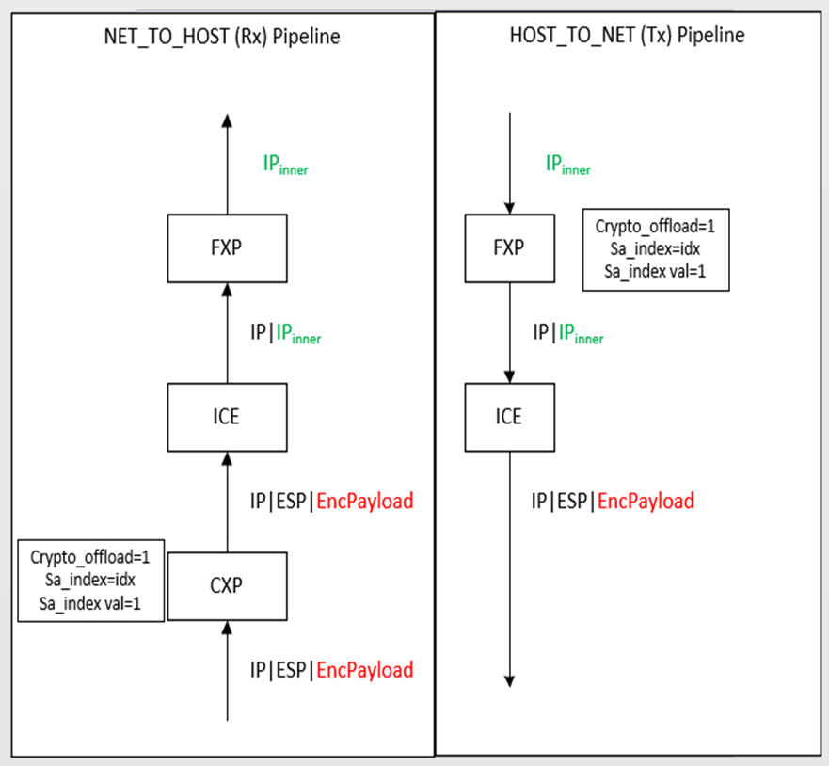
Overview Continue…
Data Plane:
ICE looks at the specific flags in the packet meta data to determine crypto offload.
If the specific packet meta data are not set, the packet will be processed as a clear packet without any modification.
ICE supports IPSec full termination for ESP protocol only.(No AH support).
Control Plane:
ICE stores the SADBs in a secure DRAM location. The control plane allocates the DRAM space and register with ICE before doing any SADB operation.
There are 256 PMAT (Private Memory Address Translation) registers are maintained within ICE for each direction. ICE supports 3 different DRAM page sizes(4K/2MB/32MB).
ICE can support 16M SAs in both egress and ingress direction with 16MB page size.
ICE uses CPFLib mailbox(ConfigQueue) mechanism to program SAs to ICE.
ICE also has internal cache to store SAs.

Slide 5
IPsec SPD & SAD
IPsec implementation on accelerators are fixed function blocks which applies IPsec directly on packets if enabled
RFC 4301 defines policy-based IPsec enablement with security policy database(SPD) and security association database(SAD)
Our IPsec offload solution is P4-based programmable IPsec flows with security policy database and non P4-based security association database
The IPsec data plane programming is separated into 2 parts.
P4 Tables compiled from the Inline IPsec P4 program.
Control blocks for Tunnel and Transport modes.
Parser support for IPsec ESP
Modify logic to encapsulate on the outer and inner headers of the packet.
IPsec OpenConfig schema based on the RFC
Configuration of the type & strength of encryption
Encryption keys w/ mechanisms to re-key
Authentication & Re-authentication mechanisms
Classification
Access Control Lists
Designed to stay aligned with the OPI Security API specification

Slide 6
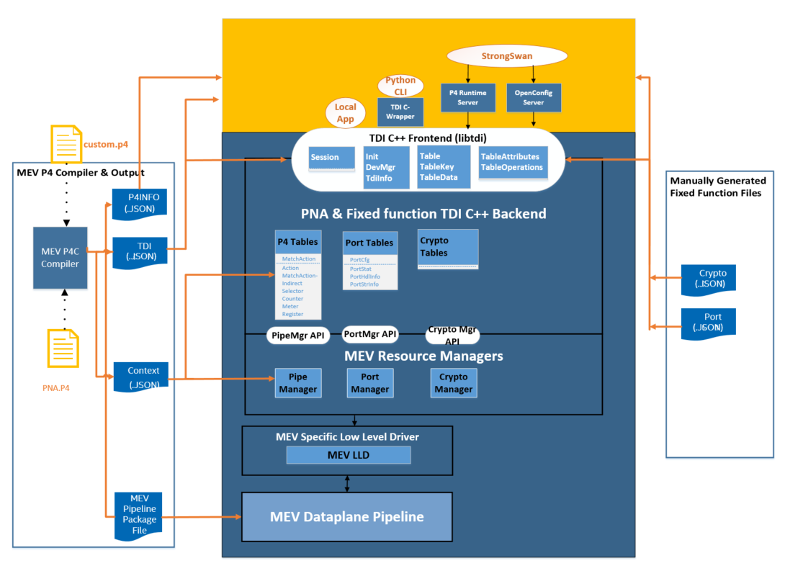
Crypto Configuration through TDI
IPsec SPD & SAD classification tables are configured through P4 based TDI tables
IPsec SAD database containing SA attributes are configured through fixed function (non-P4) TDI tables
Every configuration entity is represented as P4(e.g MatchActionDirect) or non-P4 (Port, IPsec SAD configuration) tables
Notes:
In TDI backend, each TDI class implements table specific behavior for mapping key, data, and resource mgmt. used by the table or data.
The manager layer maps the key and data to the target LLD APIs with help from the context.json.
Context.json contains information related to tdi.json entries as well as P4 DPDK pipeline specific information.

Slide 7
IPsec Requirements for infrap4d
P4RT support for set-pipe & adding entries to match-action direct (SPD rule programming)
gNMI support for new YANG model /ipsec-offload
GET on SPI value
SET & DELETE on Config SAD entry
Notification of expired entries (target -> gNMI client direction)
TLS 1.3 support
Keep software stack stateless
Scalability

Slide 8
Authentication using mTLS
Secure-by-default model
Certificate generation script provided with infrap4d, with settings matching IPAS crypto guidelines
This script sets up 1-level certificate chain using a self-signed root certificate
Endpoint certificates are mutually authenticated with mTLS (mutual TLS) to secure gRPC ports (9339 for gNMI and 9559 for P4RT)
Runtime flags available to fine tune running mode such as secure (default) or insecure modes, custom location of certificates, support gRPC request/require/force and validate client/server certificates (5 levels, defaults to strictest level)
Support for TLS 1.2 and 1.3 (will default to highest version that gRPC client supports)

Slide 9
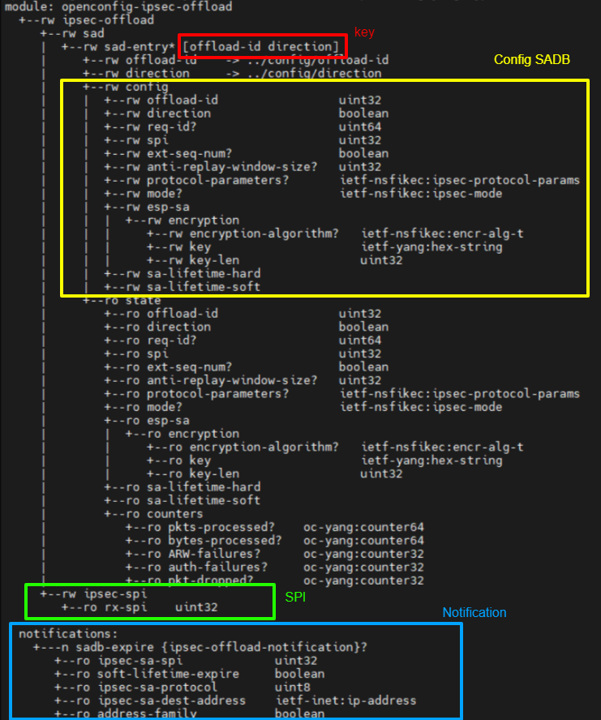
IPsec-offload YANG model
Intel-authored and open-sourced
Based on ietf-i2nsf-ikeless YANG model, with changes introduced to suit MEV-TS use case
SAD Entry uses composite key [offload-id, direction]
Config SAD gNMI message in one single block to avoid caching of sensitive data in software stack
Notification block originates from target, bubbles through software stack & pushed to gNMI client (strongSwan)

Slide 10
infrap4d operational support for IPsec
"fixed_functions" : [
{
"name": "crypto",
"tdi": "/tmp/tdi.json",
"ctx": "/tmp/ctx.json"
}
infrap4d initialization
P4SDE initialization with fixed_functions block in target_skip_p4_no_bsp.conf file
P4RT set-pipe
P4RT add match-action table entries
gNMI GET /ipsec-offload/ipsec-spi/rx-spi
gNMI SET /ipsec-offload/sad/sad-entry[offload-id=1][direction=false]/config
gNMI Subscribe /ipsec-offload
ipsec_tx_spd_table
ipsec_tx_sa_classification_table
ipsec_rx_sa_classification_table
ipsec_rx_post_decrypt_table
offload_id: 1,
direction: false,
req_id: 2,
spi: 599,
ext_seq_num: false,
anti_replay_window_size: 64,
protocol_parameters: IPSEC_PROTOCOL_PARAMS_ESP,
mode: IPSEC_MODE_TRANSPORT,
esp_payload {
encryption {
encryption_algorithm: 12,
key: "07:33:6b:12:d7:9f:56:63:0b:59:a3:9f:8b:03:d2:c1:b8:51:98:e8:04:be:53:7f:40:82:a6:11:8d:02:16:30:53:cf:7e:09",
key_len: 36,
}
},
sa_lifetime_hard {
bytes: 2000
},
sa_lifetime_soft {
bytes: 1000
}
RESPONSE
update {
timestamp: 1671644574236140072
update {
path {
elem {
name: "ipsec-offload"
}
}
val {
string_val: "ipsec-sa-spi: 599, soft-lifetime-expire: 1, ipsec-sa-protocol: 50, ipsec-sa-dest-address: 192.0.0.2, address-family: 1"
}
}
}

Slide 11
Stratum IPsec support
Controller
Stratum
infrap4d
P4Runtime
gNMI
gNOI
Switch Broker Interface
ChassisMgr
IPsec Manager
NEW
NEW
(P4) Table Manager
Fixed Function Table Manager
P4SDE
TDI C++ Frontend (libtdi)

Slide 12
Scaling Stratum
/
Path=/
…
ipsec-offload
Path = /ipsec-offload
module ipsec-offload {
…
container sad {
list sad-entry {
key “offload-id direction”;
leaf offload-id {
type leafref {
path “…/config/offload-id”;
}
}
leaf direction {
type leafref {
path “…/config/direction”;
}
}
container config {
leaf req-id {
type uint64
}
}
}
}
}
sad
Path = /ipsec-offload/sad
sad-entry
Path = /ipsec-offload/sad/sad-entry[offload-id=1][direction=false]
…
config
Path = /interfaces/sad-entry[offload-id=1][direction=false]/config
config
Path = /interfaces/sad-entry[offload-id=555][direction=true]/config
IPsec implementation in Stratum collapses the ‘config’ node by stripping keys in order to scale solution. All IPsec-offload processing performed by single node and associated handlers

Slide 13
Scaling Stratum
/
Path=/
…
ipsec-offload
Path = /ipsec-offload
module ipsec-offload {
…
container sad {
list sad-entry {
key “offload-id direction”;
leaf offload-id {
type leafref {
path “…/config/offload-id”;
}
}
leaf direction {
type leafref {
path “…/config/direction”;
}
}
container config {
leaf req-id {
type uint64
}
}
}
}
}
sad
Path = /ipsec-offload/sad
sad-entry
Path = /ipsec-offload/sad/sad-entry
config
Path = /interfaces/sad-entry/config
IPsec implementation in Stratum collapses the ‘config’ node by stripping keys in order to scale solution. All IPsec-offload processing performed by single node and associated handlers

Slide 14
Questions

Slide 15
Links & References
Infrap4d IPsec FSD: https://wiki.ith.intel.com/display/ndvswitch/IPsec+Offload
Infrap4d gRPC ports and certificate management: https://wiki.ith.intel.com/pages/viewpage.action?pageId=2716150741
TDI Attributes for IPsec notifications: https://wiki.ith.intel.com/pages/viewpage.action?pageId=2607084880
IPsec-offload YANG model: https://github.com/intel-innersource/networking.ethernet.acceleration.vswitch.p4-sde.dataplane-p4/blob/master/openconfig/oc_models/ipdk/models/ipsec-offload.yang
ICE software overview: https://wiki.ith.intel.com/display/ITSMEVTSMonterey/Inline+Crypto+Engine+Software
IPsec P4 reference file: https://github.com/intel-innersource/networking.ethernet.acceleration.vswitch.p4-sde.p4-driver/tree/main/mev_reference_p4_files/ipsec
IPsec recipe on github/ipdk-io (strongSwan plugin): https://github.com/ipdk-io/ipsec-recipe
IPAS crypto guidelines: https://readthedocs.intel.com/cryptoteam/crypto_guidelines/crypto_guidelines.html

Slide 16
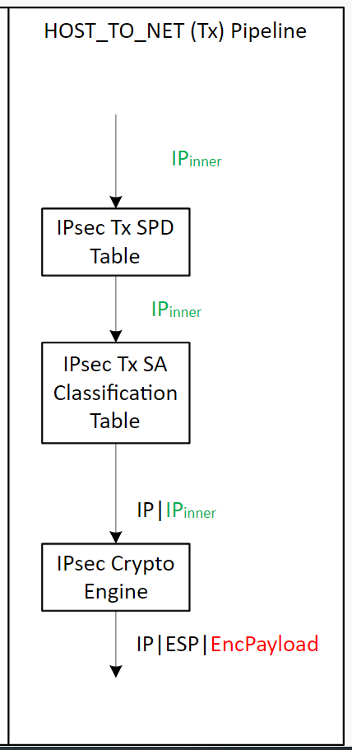
IPSec Tunnel Mode TDI API Tables (HOST_TO_NET Tx Direction)
Step | IPSec Table | P4 & Fixed Function | TDI Table for Config
​1 | ​IPsec Tx SPD Table (RFC2401 4.4.1 SPD) | P4 Match Action Table​ Key: Exact, LPM, Ternary fields Actions: Set packet metadata (CRYPTO_OFFLOAD) | MatchActionDirect Table P4 Key fields: Exact, LPM, Ternary fields P4 Action: P4 action for protect P4 action for bypass Data: None
2 | IPsec Tx SA Classification Table (RFC2401 4.4.2 Selectors) | P4 Match Action Table Key: Exact, LPM, Ternary fields Action: Set packet metadata (SA INDEX) Encapsulate tunnel IPV4 & Eth header | MatchActionDirect Table P4 Key fields: Exact, LPM, Ternary fields P4 Action: P4 action for setting SA Index P4 action for bypass Data: SA Index value MatchActionDirect Table (for encap header data) P4 Key fields: MOD data pointer P4 Action: P4 action for encapsulate tunnel header Data: Tunnel IPV4 & Eth header fields (S-IP, D-IP, S-MAC, D-MAC, ..)
3 | IPsec Crypto Engine (RFC2401 4.4.3 SAD) | Fixed Function Key: SA Index Action: Insert ESP header and encrypt payload w/ SA fields | IPSec SAD Table Fixed Key fields: SA Index Fixed Action: HW fixed action to insert ESP header and encrypt & authenticate payload Data: Crypto_Tag, IPSec protocol, SPI, key, algorithm, IV, lifetime, …

Slide 17
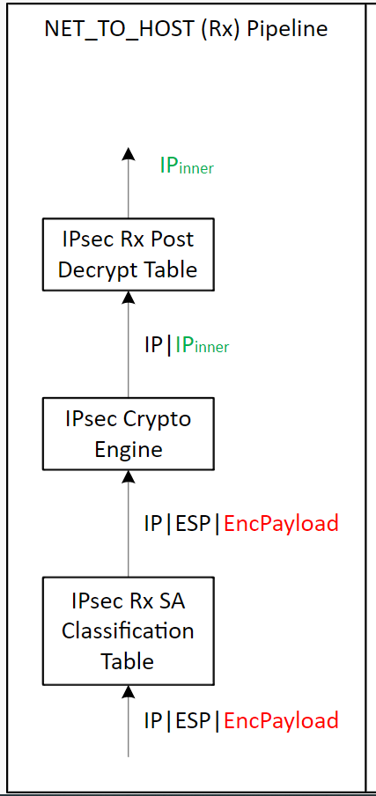
IPSec Tunnel Mode TDI API Tables (NET_TO_HOST Rx Direction)
Step | Table | P4 & Fixed Function | TDI Table for Config
​1 | IPsec Rx SA Classification Table​ (RFC2401 4.4.3 SAD) | P4 Match Action Table Key: Exact header fields + SPI Action: Set packet metadata (SA INDEX) | MatchActionDirect Table P4 Key fields: Exact match header + SPI fields P4 Action: P4 action to set packet metadata P4 action for bypass Data: SA INDEX
2 | IPsec Crypto Engine (RFC2401 4.4.3 SAD) | Fixed Function Key: SA Index Action: Remove ESP header and decrypt & authenticate payload Set metadata (crypto_status, crypto_tag) | IPSec SAD Table Fixed Key fields: SA Index Fixed Action: HW fixed action to remove ESP header and decrypt & authenticate payload.. Data: Crypto_Tag, IPSec protocol, SPI, key, algorithm, IV, lifetime, anti-replay window
3 | IPsec Rx Post Decrypt Table (RFC2401 4.4.1 SPD) | P4 Match Action Table Key: Exact match on Crypto_tag Action: Decapsulation of tunnel IPV4 & Eth header | MatchActionDirect Table P4 Key fields: Exact match on crypto_tag P4 Action: P4 action for decapsulate tunnel IPV4 & Eth header (tunnel mode) P4 action for bypass (transport mode) Data: None

Slide 18
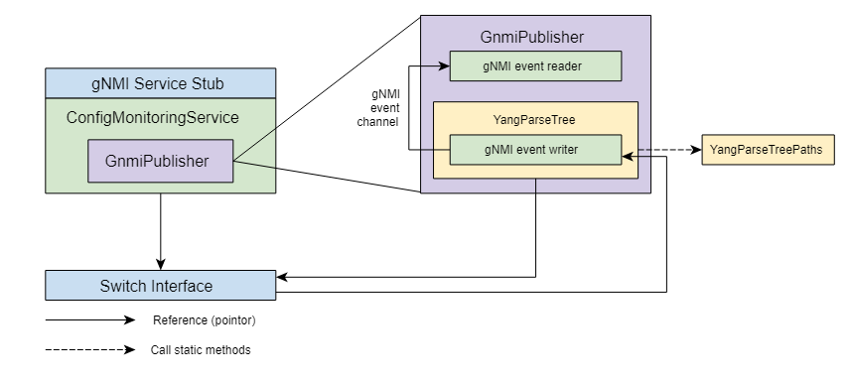
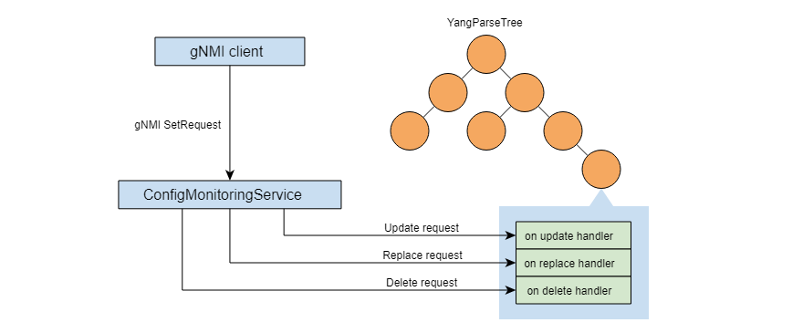
Stratum Design

